Slide 1
Stepwise filtering and restoration approach for robotic vision tasks

Slide 2
1. Stepwise filtering and restoration
Images acquired by robotic vision systems are corrupted by noise (sensor read noise, photon noise, compression artifacts) and degradations (blur from motion/defocus).
A stepwise filtering and restoration pipeline improves downstream tasks (feature detection, localization, object recognition) by increasing SNR and restoring spatial details.

Slide 3
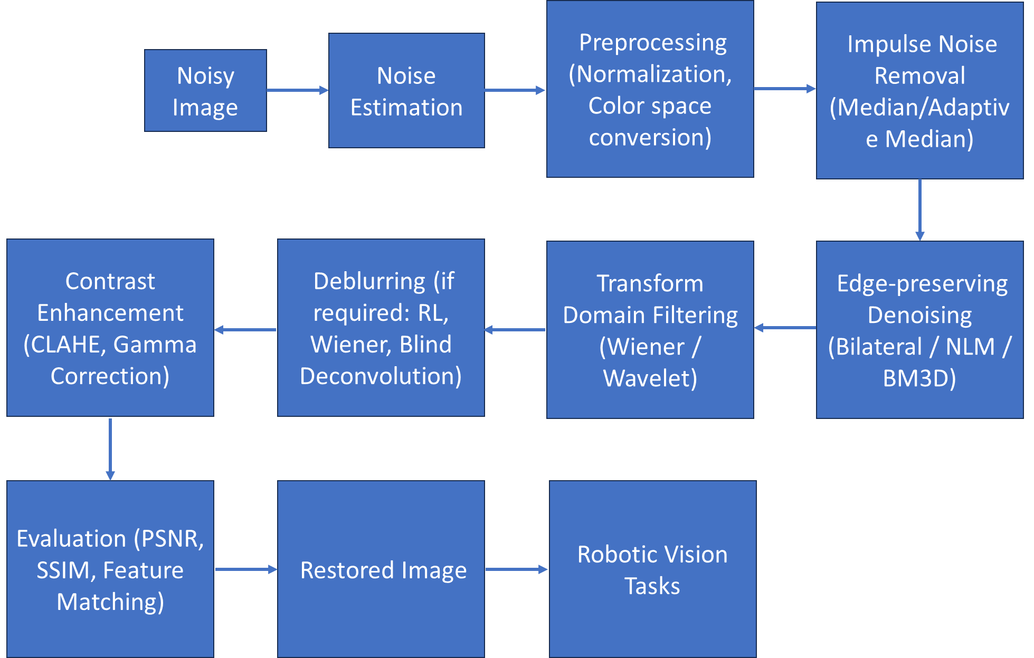
2. Overview of the proposed pipeline

Slide 4
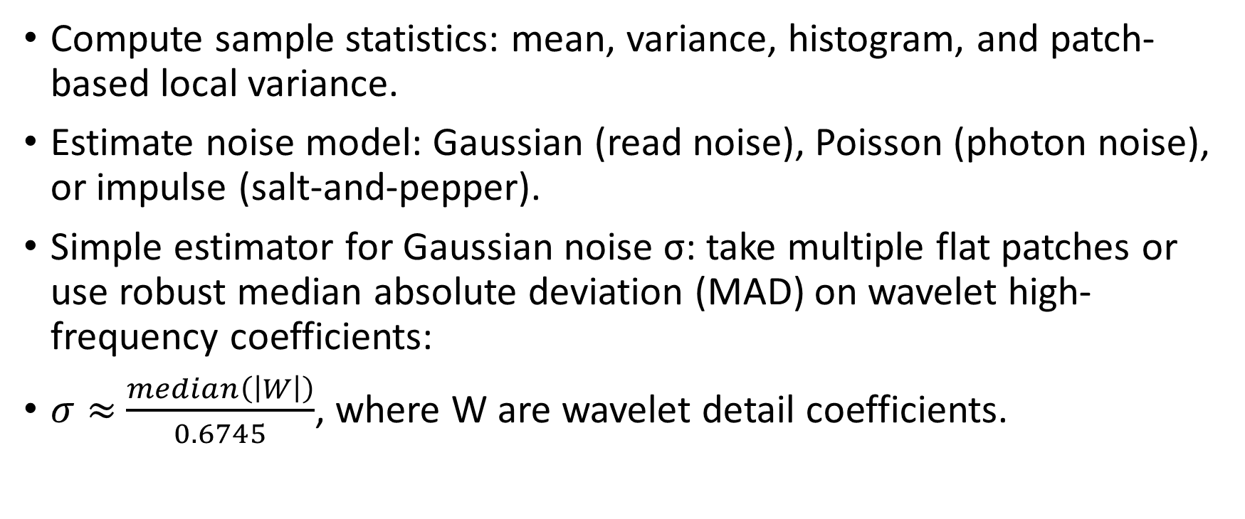
3. Step 1 — Inspect data & estimate noise
Compute sample statistics: mean, variance, histogram, and patch-based local variance.
Estimate noise model: Gaussian (read noise), Poisson (photon noise), or impulse (salt-and-pepper).
Simple estimator for Gaussian noise σ: take multiple flat patches or use robust median absolute deviation (MAD) on wavelet high-frequency coefficients:
$σ≈$​$\frac{median\left(\left|W\right|\right)}{0.6745}$, where W are wavelet detail coefficients.

Slide 5
3. Step 2 — Radiometric correction & normalization
Subtract bias/dark frame if available, divide by flat-field to correct vignetting.
Normalize intensities (0–1 or 0–255).
Convert to grayscale if color not needed for downstream tasks.
If using color, operate in a perceptual space (e.g., YCbCr) and denoise luminance (Y) primarily.

Slide 6
3. Step 3 — Handle impulse / salt-and-pepper noise
Use median filter (window 3×3 or 5×5) or adaptive median to remove isolated spikes while preserving edges.
Adaptive median increases window until median differs from boundary values, good for variable densities.

Slide 7
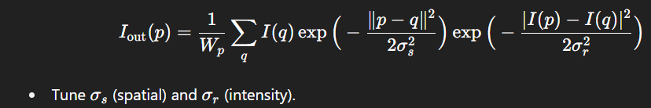
3. Step 4 — Edge-preserving spatial denoising
Bilateral filter (good baseline): preserves edges via spatial & range kernels.
Non-Local Means (NLM): averages patches weighted by patch similarity; good for textured regions.
BM3D (Block-Matching and 3D filtering): state-of-the-art classical method — groups similar patches and does collaborative filtering in transform domain. Use when high-quality denoising is required.

Slide 8

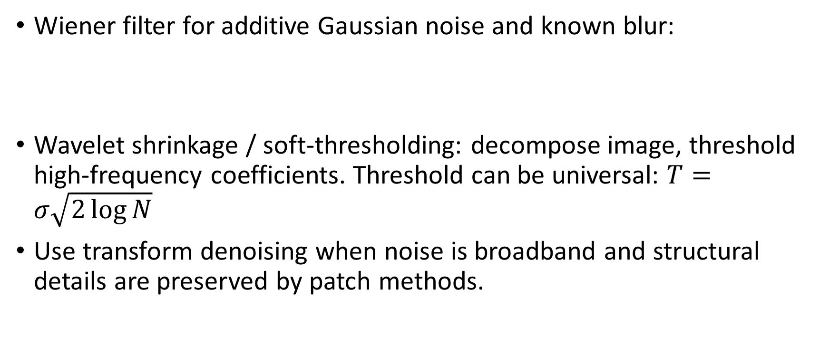
3. Step 5 — Transform / frequency-domain denoising
Wiener filter for additive Gaussian noise and known blur:
Wavelet shrinkage / soft-thresholding: decompose image, threshold high-frequency coefficients. Threshold can be universal: $T=σ\sqrt{2\log{N}}$
Use transform denoising when noise is broadband and structural details are preserved by patch methods.

Slide 9
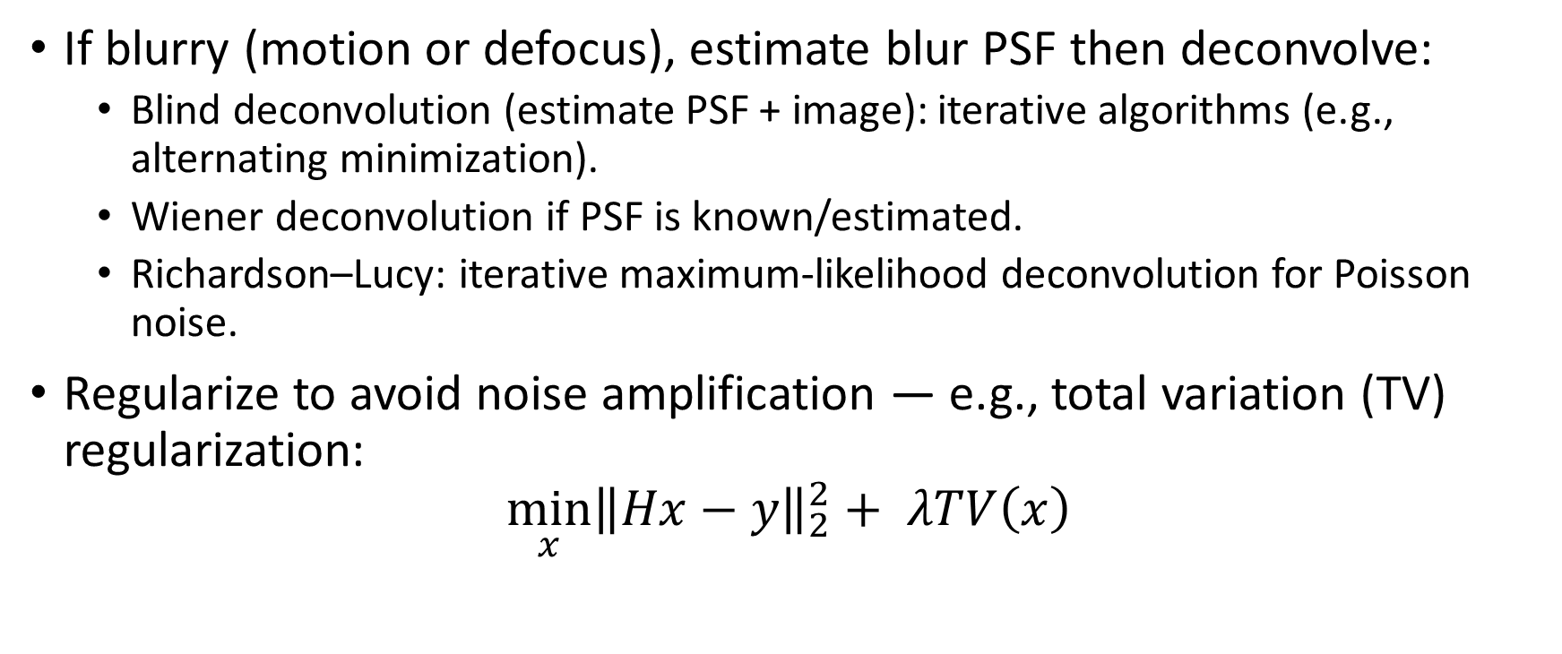
3. Step 6 — Image restoration (deblurring)
If blurry (motion or defocus), estimate blur PSF then deconvolve:
Blind deconvolution (estimate PSF + image): iterative algorithms (e.g., alternating minimization).
Wiener deconvolution if PSF is known/estimated.
Richardson–Lucy: iterative maximum-likelihood deconvolution for Poisson noise.
Regularize to avoid noise amplification — e.g., total variation (TV) regularization:
$${\min_{x}\left\|Hx−y\right\|}_{2}^{2}+ λTV\left(x\right)$$

Slide 10
3. Step 7 — Contrast / local tone correction
Apply contrast-limited adaptive histogram equalization (CLAHE) on luminance to avoid boosting noise.
Gamma correction if camera response is nonlinear.

Slide 11
3. Step 8 — Final cleanup & morphological ops
Use small morphological opening/closing to remove tiny residual artifacts in binary/mask tasks.
Sharpening: unsharp mask with small radius and low strength if slight sharpening is required.

Slide 12
4. Evaluation metrics & verification
PSNR (Peak Signal-to-Noise Ratio) — easy but doesn’t match perceptual quality.
SSIM (Structural Similarity Index) — better for perceived quality.
MSE (Mean Squared Error) — basic indicator.
Edge preservation index / Gradient similarity — to verify features used by robotic vision (e.g., Harris corners).
Task-level metrics: detection accuracy, feature matching score, localization error — ultimately these matter most for robotic tasks.
Always evaluate on held-out test images and, where possible, with ground-truth clean images or synthetic noise added to clean images.

Slide 13
5. Practical implementation notes & parameter selection
Start with automatic noise estimation, then:
For low Gaussian noise (σ < 10 on 0–255): bilateral / small Gaussian + NLM.
For moderate-to-high noise: BM3D or deep-learning denoisers (DnCNN, FFDNet) if resources allow.
Trade-offs:
Bilateral/NLM: slower on large images — use fast approximations or downsample for parameter search.
BM3D: excellent quality; more complex to implement but available in libraries.
Implementation libraries: OpenCV (median, bilateral, fast nonlocal means), scikit-image (denoise_nl_means), BM3D packages, PyTorch/TensorFlow for DL denoisers.
For real-time robotic vision: use fast filters (guided filter, fast bilateral, approximate NLM) or run heavy denoising on a GPU.

